Slide 1
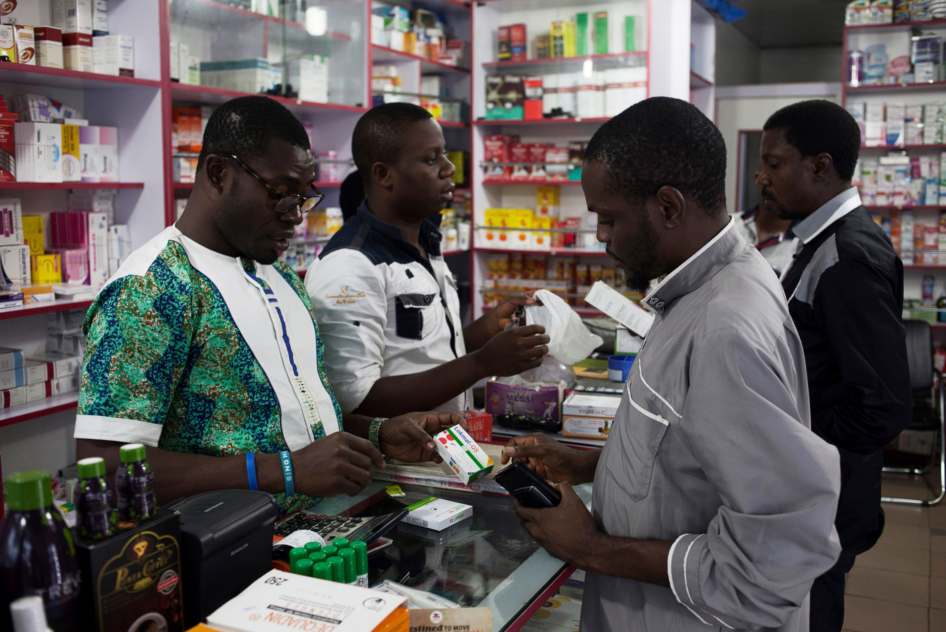

[COUNTRY, YEAR]
Module 5. Questionnaire deep dive

Slide 2
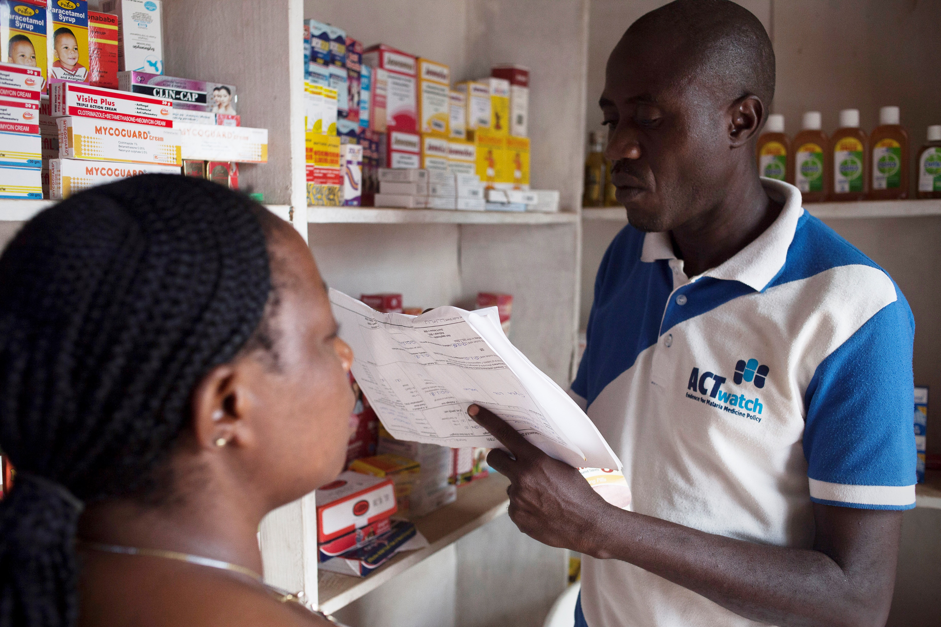
Agenda
5.1 Overview of questionnaire
5.2 Differences for wholesale outlets
5.3 Differences for informal outlets
5.4 Interview technique and obstacles
5.5 Discussion of the questionnaire in local language(s)

Slide 3
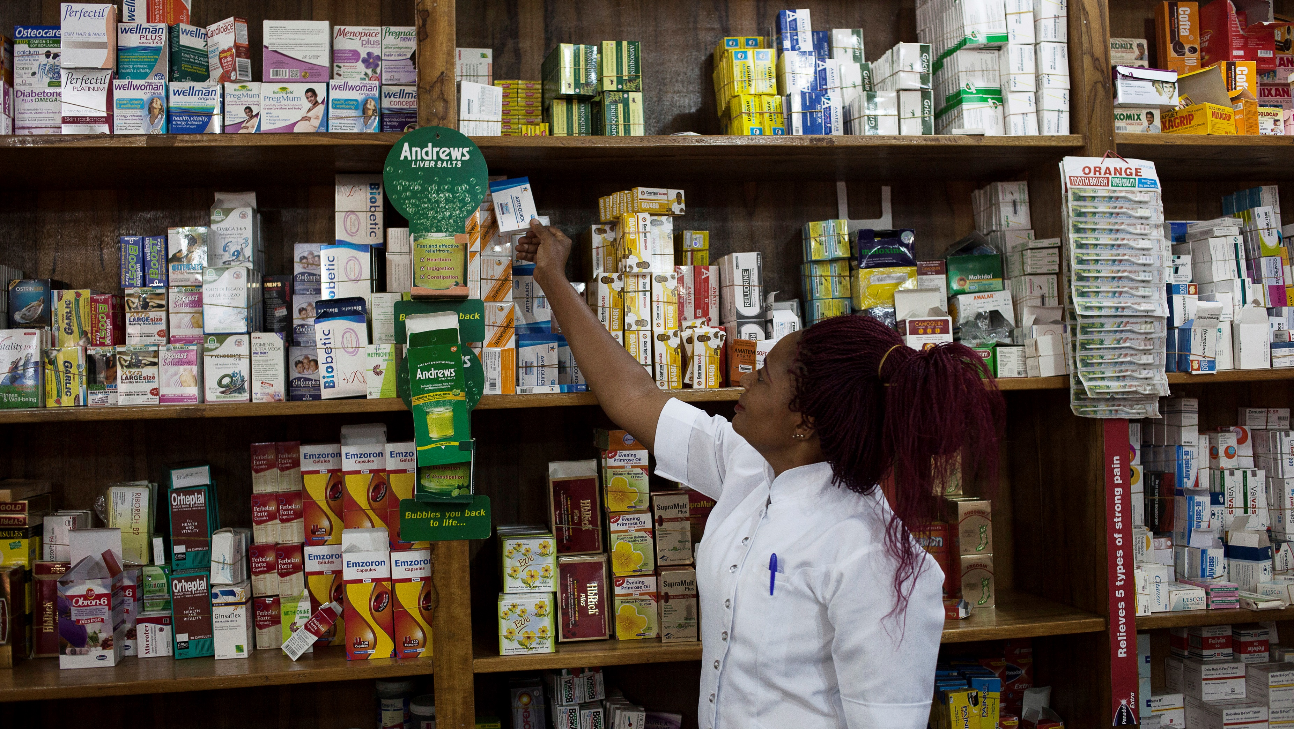
5.1 Questionnaire overview

Slide 4
TRAINER NOTES
Objective:
Help data collectors understand the structure of the questionnaire, how to follow skip logic, and how to correctly record responses during interviews and product audits.
Prompts & Answers:
What are the main sections of the questionnaire? ➔ Census, Eligibility & Consent, Provider Interview, Digital, Supplier Info, Product Audits (AM & RDT), Registration, Interview Status.
How do you know what to answer or skip? ➔ Follow skip logic programmed into the form — only relevant questions appear. ➔ Never leave blanks: use codes like -9995 (Not applicable), -9997 (Refused), -9998 (Don’t know).
What are “repeat groups”? ➔ Sections that repeat based on number of entries — e.g., one group per supplier or product.
How do you enter answers? ➔ As shown: ALL CAPS, use dropdowns/buttons when available, and follow input instructions. ➔ Do not read hints or skip notes aloud.

Slide 5
At the end of this presentation: you should be able to:
Understand the general structure and format of the detailed questionnaire.
Know how to correctly record provider responses.
Understand how to follow skip logic programmed in the form.
Review ways of explaining technical terms in local languages.
Notes:
animation

Slide 6
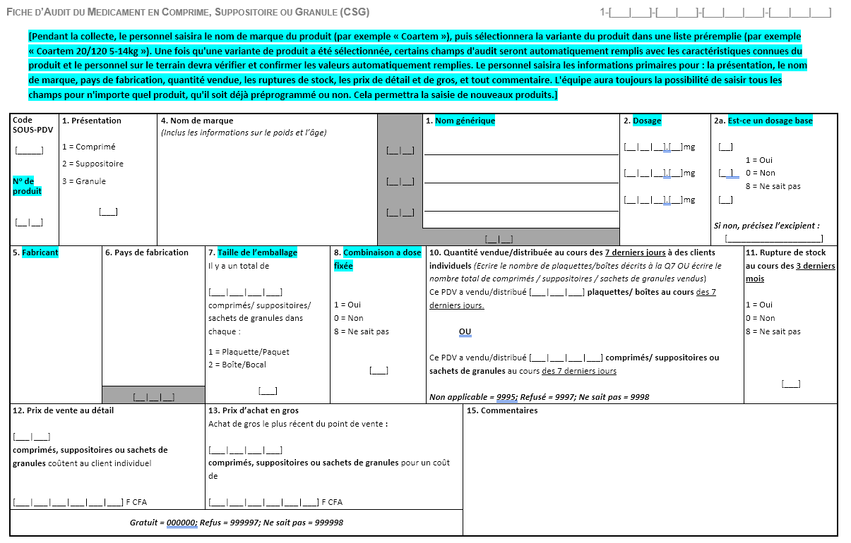
Can you name the main sections of the interview & audit questionnaire?
Census information
Outlet characteristics
Eligibility questions
Operational practices
Provider characteristics
Malaria knowledge
Digital preparedness/ practices
AM suppliers
Product supplier information
RDT suppliers
Product audits
Antimalarials
Interview status
RDTs

Slide 7

Questionnaire GUIDE
It is important that you understand the structure of the questionnaire so that you can respond appropriately.
The questionnaire is organized into the sections presented in the last slide.
Each question has:
Responses – multiple choice (select one, select multiple, numbers, free text, etc.
Hints or instructions programmed into the questionnaire below certain questions. Remember not to read these aloud!
Skip logic! The question flow is programmed so that only relevant questions are shown depending on former responses.

Slide 8
Which fields do I have to fill in?
Complete all questions.
Non-applicable questions will be skipped based on the programmed skip logic.
If the respondent does not know the answer or refuses to answer a question, do not leave the boxes blank.
Select not applicable, refused, etc. or use appropriate codes.
Either push buttons or hints with appropriate codes should be provided for each question e.g.:
-9995= Not applicable
-9997= Refused
-9998= Don't know
Write in ALL CAPITAL LETTERS.

Slide 9
Time frame
Several questions have a time frame. They are highlighted in bold.
Read the question as written
For example:
Are there any antimalarial drugs that are sold out today, but that you've had in stock for the past 3 months?

Slide 10
REPEAT GROUPS
Some sections use repeat groups
This is a feature in ODK that allows the same group of questions to be asked repeatedly- either for a set number of times or until you mark the group as complete
We will discuss examples in subsequent sections.
e.g.
Supplier information questions are asked for EACH supplier
Antimalarial and RDT info are asked for EACH product.

Slide 11
Review of provider's questionnaire
Let's go through all the questions in the questionnaire.
Interviewers must be prepared to answer questions from providers such as:
"What does this question mean?
"Why are you asking me this question?"

Slide 12
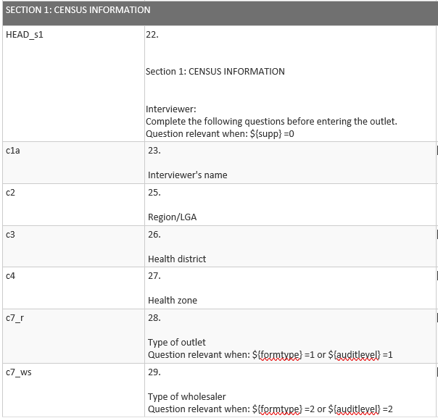
Section I: Census information
Note for facilitators: Update this slide with the questionnaire to be used in your study.
This section is completed before entering the outlet!!
Record information about the outlet type and location
Refresher:
Are we taking GPS of informal outlets?

Slide 13
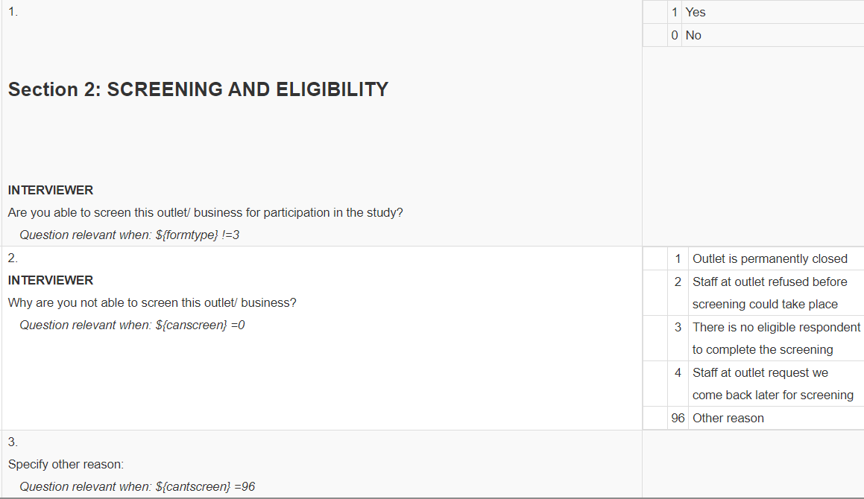
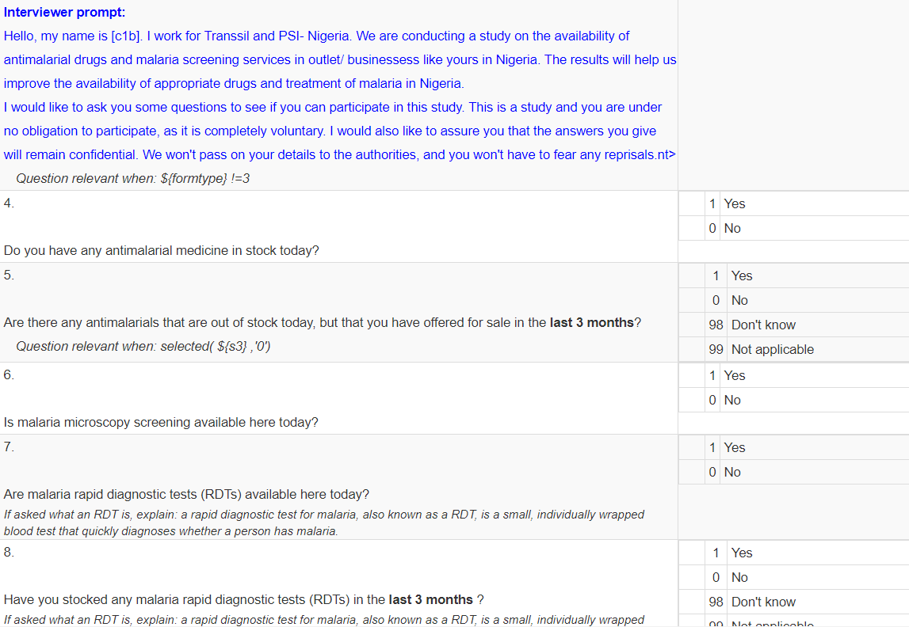
Section 2: Eligibility and consent
Note for facilitators: Update this slide with the questionnaire to be used in your study.
Now you can enter the outlet and screen, assess eligibility, and obtain consent
Refresher:
What are the steps we take when approaching an outlet?
What makes an outlet eligible or not?
How are we obtaining consent?

Slide 14
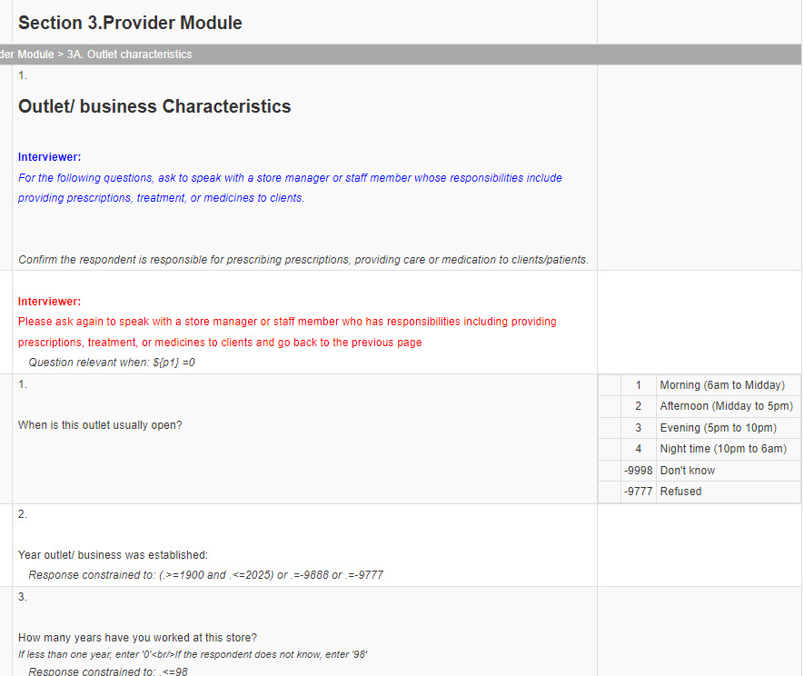
Section 3: provider interview
Note for facilitators: Update this slide with the questionnaire to be used in your study.
Complete this section by addressing the person in charge of prescribing and providing care or medication to customers/patients.
Quiz ☺ Who took good notes?
What are the sub-sections of the Provider Module?
Outlet characteristics
Operational practices
Malaria knowledge

Slide 15
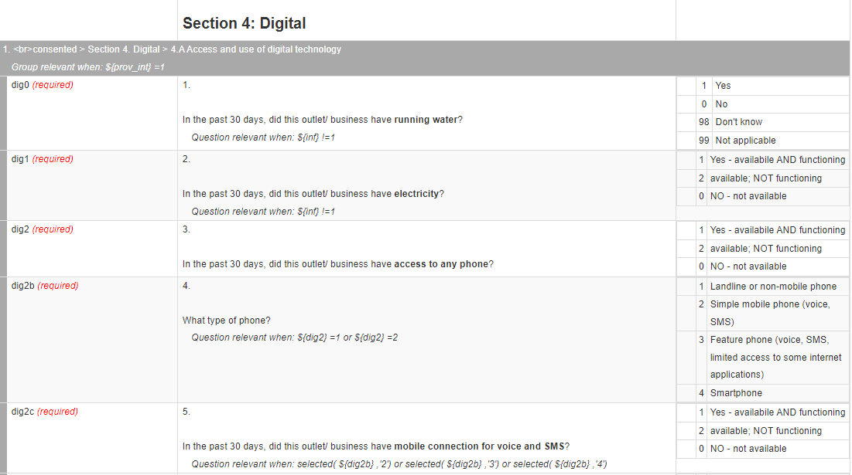
Section 4: Digital
Note for facilitators: Update this slide with the questionnaire to be used in your study.
This section is reserved for the person responsible for data management at the facility or point, or the facility sponsor.

Slide 16
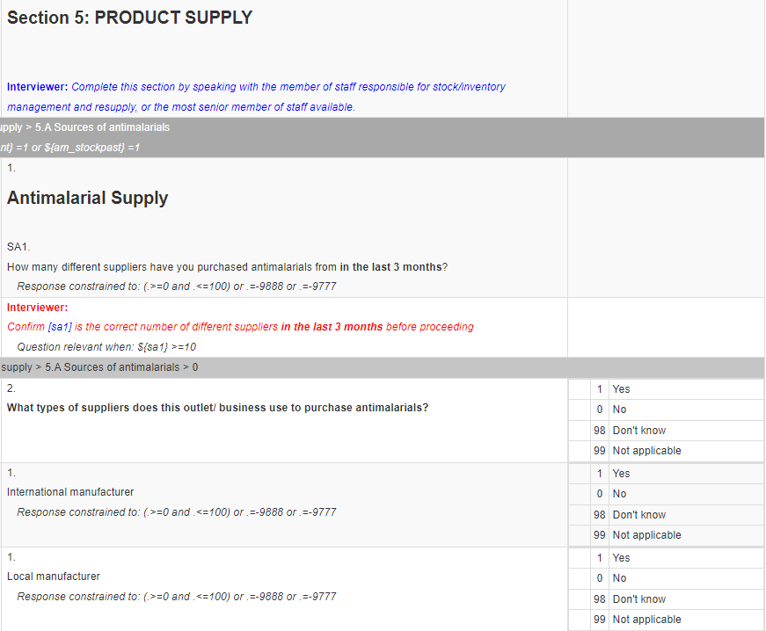
Section 5: Suppliers
Note for facilitators: Update this slide with the questionnaire to be used in your study.
This section is reserved for the member of staff responsible for inventory management and supply orders, or the highest-ranking member of staff available.
Refresher:
Why is this section important?
What will this data be used for in the field?

Slide 17
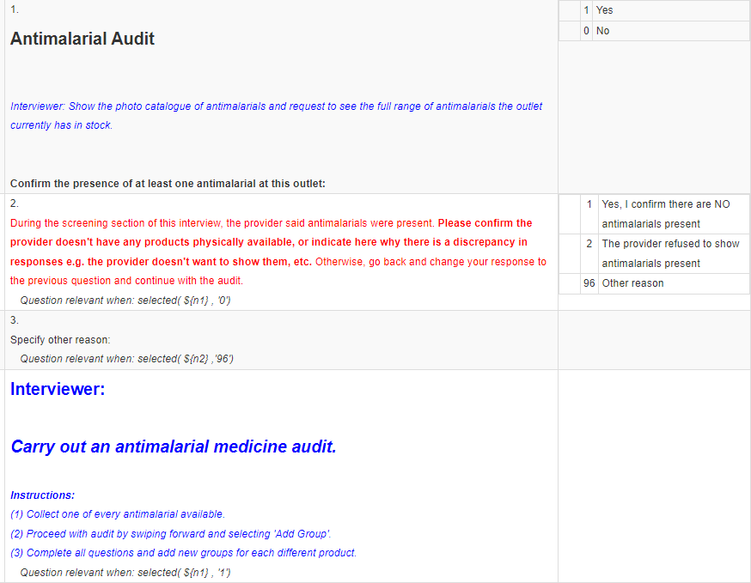
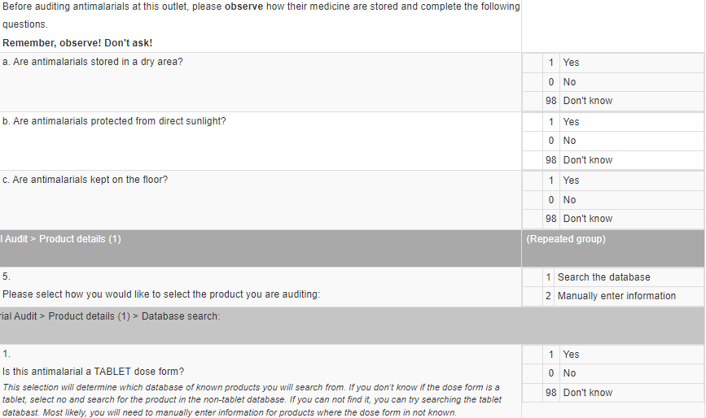
Section 6: antimalarial audit
Note for facilitators: Update this slide with the questionnaire to be used in your study.
Refresher:
Can you list the information we capture from antimalarial packaging?
What about information we ask about each product from the provider?

Slide 18
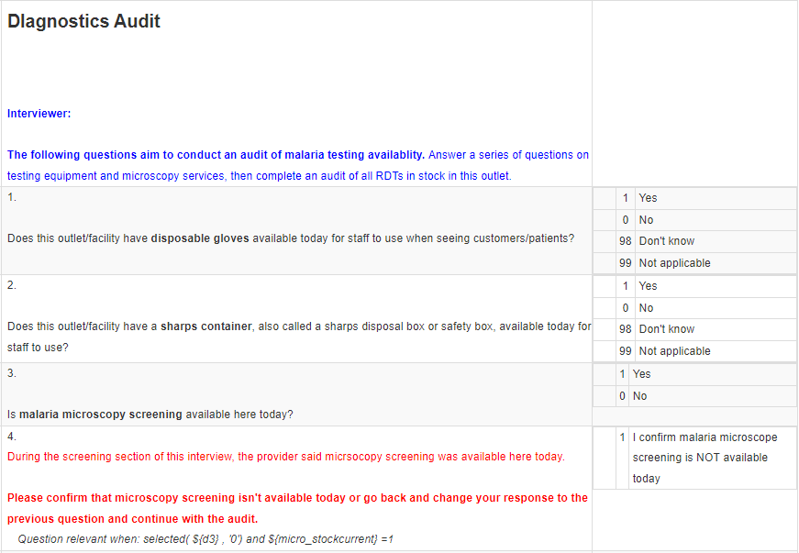
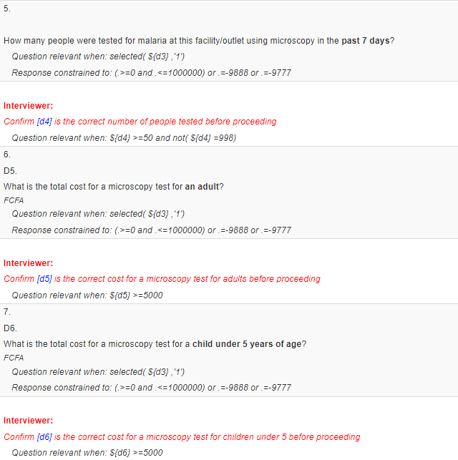
Section 7: Diagnostic Audit
Note for facilitators: Update this slide with the questionnaire to be used in your study.
This section concerns the availability of the malaria blood test. Answering the questions may require discussion with more than one staff member. If the respondent does not know the answer to the question in this section, ask to speak to another member of staff who can provide the information.
Refresher:
What are the main parasites we are looking for on RDT packaging?

Slide 19
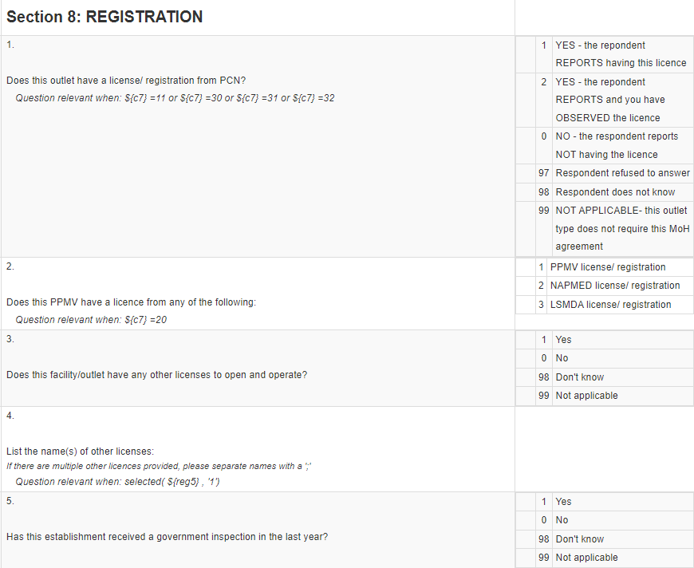
Section 8: Registration status
Note for facilitators: Update this slide with the questionnaire to be used in your study.
This section concerns the authorization to open a business with the MoH, etc. If the respondent does not know the answer to the question in this section, ask to speak to another member of staff who can provide the information.
If the respondent refuses to answer record this and move on.
Refresher:
Do we interview un-registered outlets?

Slide 20
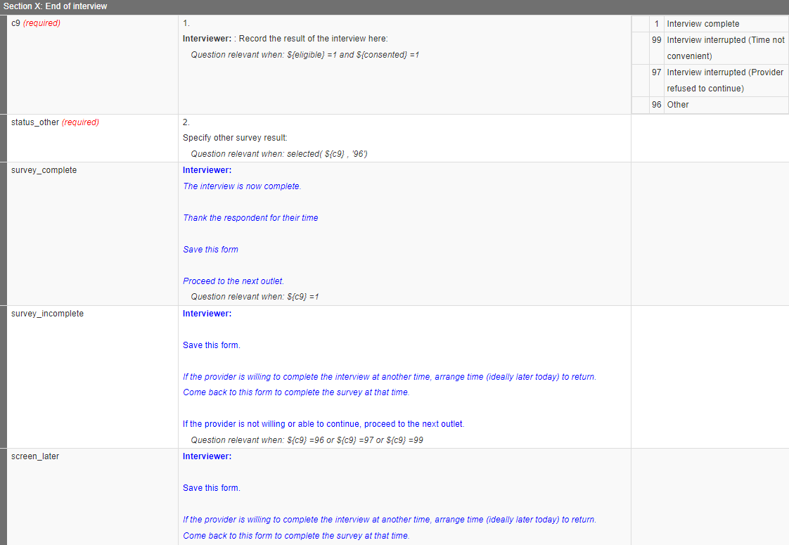
Section x: End of interview
Note for facilitators: Update this slide with the questionnaire to be used in your study.
Refresher:
What do we do if an outlet is temporarily closed?

Slide 21
Example
Note for facilitators: Update this slide with the questionnaire to be used in your study. Update the text highlighted in yellow.
The date is July 12, 2024. When the interviewer visits the outlet for the 1st time, the interview is started, but then the outlet closed for lunch mid-way. What will we record for question C9?

Slide 22
5.2 Wholesale differences

Slide 23
TRAINER NOTES
Objective:
Help data collectors understand how the wholesale version of the questionnaire differs from the retail version in structure, content, and flow.
Prompts & Answers:
Are wholesalers asked different questions? ➔ The overall structure is the same, but some questions are added, skipped, or tailored based on wholesaler status
How is a wholesale outlet identified? ➔ Selected at the start of the form, or flagged if a retail outlet reports selling for resale
What are the main changes? ➔ Census outlet type options differ ➔ Additional questions on clients, distribution practices, and resale ➔ Provider knowledge questions may be skipped ➔ Wholesale price fields appear in product audit
What if a retail outlet is also a wholesaler? ➔ These are captured during screening and the questionnaire will adapt automatically

Slide 24
The wholesaler questionnaire includes all of the same sections as the retail questionnaire!
Census information
Outlet characteristics
Eligibility questions
Operational practices
Provider characteristics
Malaria knowledge
Digital preparedness/ practices
AM suppliers
Product supplier information
RDT suppliers
Product audits
Antimalarials
Interview status
RDTs

Slide 25
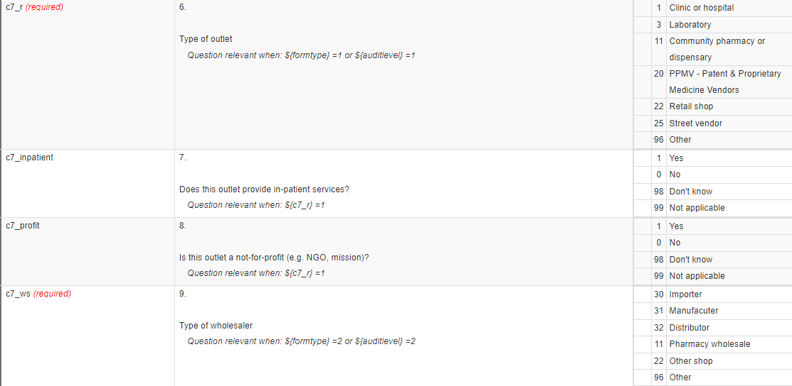
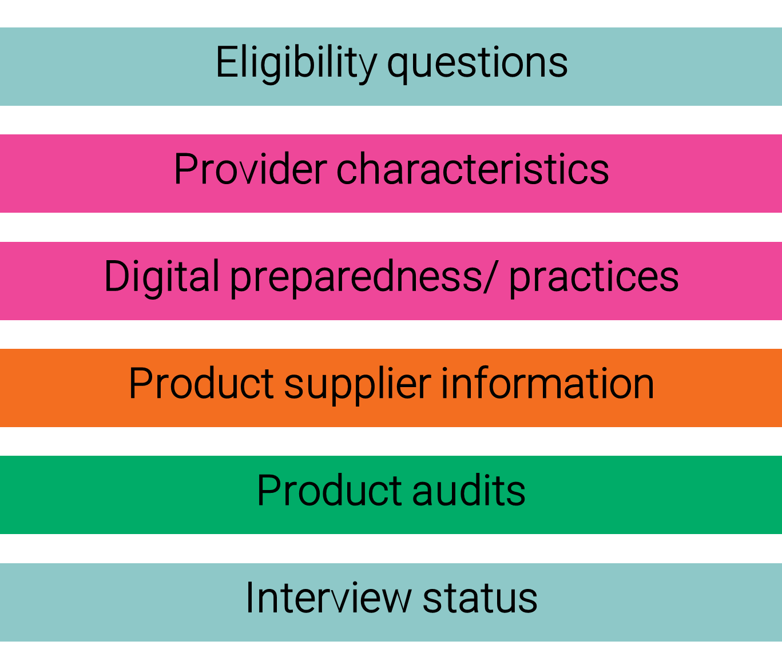
Minor changes
Note for facilitators: Update this slide with the questionnaire to be used in your study.
Census information
If a wholesale form is selected at the start of the interview, the outlet types you are given will be different
Other sections are also tailored to ask questions specific to wholesalers … or skip questions that are not relevant to wholesalers (like questions on provider knowledge)

Slide 26
MAJOR changes
Provider characteristics
If a wholesale form is selected at the start of the interview OR if the retail outlet reports selling products for resale, additional questions will be included on their business practices
These include who their customers are, where they are located, how they distribute, etc.
Product audits
Similarly in the product audits, if the wholesale form is selected or the retail outlet reports supplying commodities, additional questions on wholesale prices and practices will be included

Slide 27
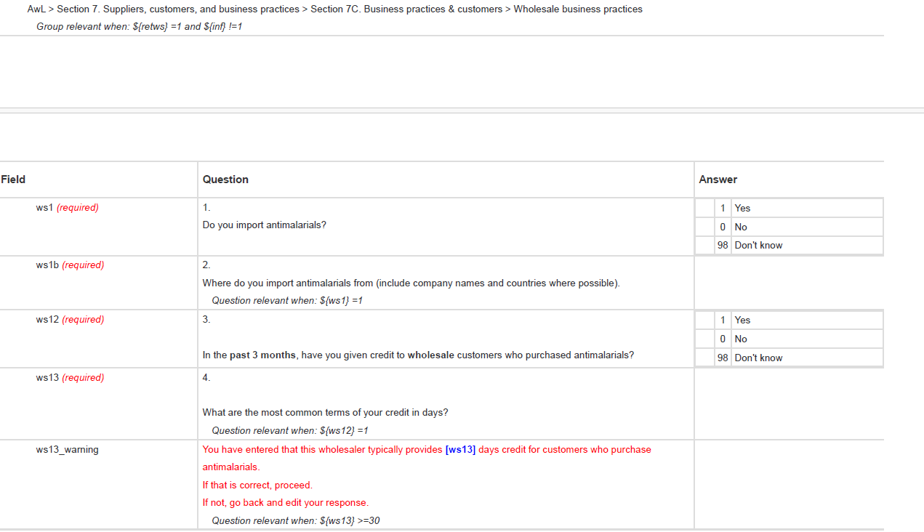
Note for facilitators: Update this slide with the questionnaire to be used in your study.

Slide 28
5.3 Informal differences

Slide 29
TRAINER NOTES
Objective:
Help data collectors understand how the questionnaire adapts for informal outlets, and how to ensure respondent confidentiality while still collecting key product data.
Prompts & Answers:
What is an informal outlet? ➔ An unregistered or unlicensed outlet (e.g., street vendor, market stall, general shop selling medicines).
Is the full questionnaire used? ➔ Yes, but with tailored skip logic — some sections (like provider characteristics, GPS, or registration) may be skipped.
Why are some questions skipped? ➔ To protect the identity of the outlet and provider. ➔ To reduce burden on providers and focus on essential data.
What should still be completed? ➔ Product audits (antimalarials and RDTs). ➔ All possible information on availability, price, and sales volume.
Can a provider stop the interview? ➔ Yes — remind them the survey is voluntary and confidential.

Slide 30
At informal outlets, we will ask only a subset of questions, but the interview structure remains the same
Census information
Outlet characteristics
Eligibility questions
Operational practices
Provider characteristics
Malaria knowledge
Digital preparedness/ practices
AM suppliers
Product supplier information
RDT suppliers
Product audits
Antimalarials
Interview status
RDTs

Slide 31
Skip logic changes
Census information
If an informal outlet type is selected, this will change the skip logic throughout the form so that certain questions are not asked.
This is primarily to protect the identity of the respondent and the outlet.
Most of the geographic information and provider interview are skipped.
All products should still be audited and as much information on products, prices, and volumes sold should be obtained.
Remember that providers can refuse to continue an interview at any time;
Remind respondents at informal outlets that this survey is for informational purposes only.

Slide 32
5.4 Interview techniques

Slide 33
TRAINER NOTES
Objective:
Equip data collectors with effective strategies for conducting respectful, accurate, and efficient interviews while building provider trust.
Prompts & Answers:
How to introduce itself? ➔ Use the approved script in the tool. ➔ Clearly state the name, organization, and the purpose of the survey.
What makes a good interviewer? ➔ Polite, confident, neutral, attentive. ➔ Uses non-judgmental tone, does not lead or guess answers.
What if the provider doesn’t understand a question? ➔ Calmly rephrase or repeat. ➔ Do not skip or create the own version - use clarification notes if available.
How to manage sensitive questions? ➔ Ask in a private setting when possible. ➔ Reassure confidentiality and allow the provider to skip if uncomfortable.

Slide 34
At the end of this presentation, you should be able to
Understand best practices for completing a data collection tool.
Understand how to establish good rapport with the respondent.

Slide 35
General instructions for completing a data collection tool
It is essential you understand each question we have in the questionnaire very well!
Consider: what information are we trying to obtain by asking a question?
You will need to be able to explain to participants WHY we are asking each question if they ask you.
Learn how to deal with problems that may arise during an interview
Follow the specific instructions for the various tools
Don't ask questions aloud if you are instructed to observe
Do/ do not read responses depending on instructions
Etc.

Slide 36
RESPONSE TYPES
The questionnaire includes questions with pre-coded answers AND questions that have no pre-coded answers
Pre-coded answers are listed in the questionnaires.
Circle/click or write the number (code) corresponding to the answer.
Non-coded questions will be free text, dates, or numeric.
To enter the answers to these questions, write/ type the respondent's answer in the space provided.

Slide 37
Asking the questions
Ask each question exactly as it is written in the collection tools.
Speak slowly and clearly.
Repeat the question as needed/ requested.
If, after repeating the question, the respondent still doesn't understand:
Ask the question in another way…
Ask additional questions to get at the answer…
BUT! be very careful not to alter the meaning of the original question.
Remain "neutral" and do not suggest any response on the part of the respondent.

Slide 38
ASK: How DO YOU establish a good rapport with the respondent?
Make a good first impression.
Ask for the respondent's consent to the interview.
Always take a positive approach.
Assure the respondent of the confidentiality of answers.
Answer the respondent's questions frankly.

Slide 39
Summary tips
Be neutral throughout the interview.
Never suggest answers to respondents.
Do not change the wording or sequence of questions.
Be tactful with hesitant respondents.
Don't have preconceived ideas, don't assume answers.
Don't rush the interview.
Be communicative and open.

Slide 40
Summary tips
Understand the wording of questions before administering them.
Use common sense to check answers for plausibility and consistency.
Enter answers correctly to facilitate data analysis and processing.
Be familiar with the main objectives of ACTwatch Lite.

Slide 41
Summary tips
Prepare for survey disruptions:
Continue the interview and collect as much information as possible.
Summarize any missing information for the respondent and, if possible, give them time to prepare it.
Schedule a follow-up appointment to fill in the remaining gaps.

Slide 42
5.5 Local Language

Slide 43
TRAINER NOTES
Objective:
Ensure data collectors can explain the study and ask questions clearly using local language when needed, while maintaining accuracy and neutrality in wording.
Prompts & Answers:
Why is local language important? ➔ Helps providers understand the questions clearly ➔ Builds trust and encourages full participation
Can I translate questions freely? ➔ No - always use the agreed translations or pre-approved terminology ➔ Translating incorrectly may change the meaning of the question
What if a word doesn’t translate directly? ➔ Use an agreed phrase or explain using clear, simple terms ➔ Ask the field team supervisor or refer to the language discussion sheet
What if the provider responds in a different dialect? ➔ Ask for clarification ➔ Record the answer accurately, then write a comment if needed

Slide 44
Review of technical terms you need to be able to explain in the local language
e.g.
Antimalarial
Microscopic malaria test
Malaria/RDT test kits
Simple/severe malaria
First-line treatment for malaria
The most effective antimalarial
Health qualification (diploma, certificate, etc.)
What are local translations for these key words?
What other terms are key for this study?

Slide 45
Working groups
In groups, review the questionnaire together and discuss translations, potential challenges
15 minutes
We will close with a brief summary from each group and discussion.
15 minutes

Slide 46

Annex

